Slide 1
Hep C U Later Eliminating Hepatitis C in England

Slide 2
Hepatitis C
What is Hepatitis C?
Hepatitis C is a blood borne virus which affects the liver, causing liver disease, cancer and death
In the UK, it mostly affects people who have shared drug injecting equipment
Many populations affected by hepatitis C can experience barriers to accessing healthcare and stigma from lac of understanding
Around 60,000 people are estimated to be living with chronic HCV infection but are unaware (England 2023)
People affected by hepatitis C are often affected by stigma, including from healthcare staff
The World Health Organisation aims to eliminate viral hepatitis by 2030, NHS England want to achieve this ahead of the 2030 target
Testing and Treatment:
Testing is simple
Hepatitis C can be cured in 97% of cases
Treatment is easy – tablets for 8-12 weeks

Slide 3
Risk Factors for Hepatitis C
There are a number of risk factors for hepatitis C…
• Sharing drug injecting equipment or other drug using equipment (including syringes, needles, spoons, water or filters for drawing up, crack pipes, or snorting straws/notes).
• Blood transfusion before 1996.
• Dental or medical treatment abroad in unsterile conditions.
• Piercing, tattoo, electrolysis, semi-permanent make up or acupuncture using equipment which may have not been sterilised.
• Vertical transmission (from mother to baby during childbirth).
• Unprotected sex with someone who may have had hepatitis C (especially if there were opportunities for blood to blood contact during sex).
• Needle stick injury.

Slide 4
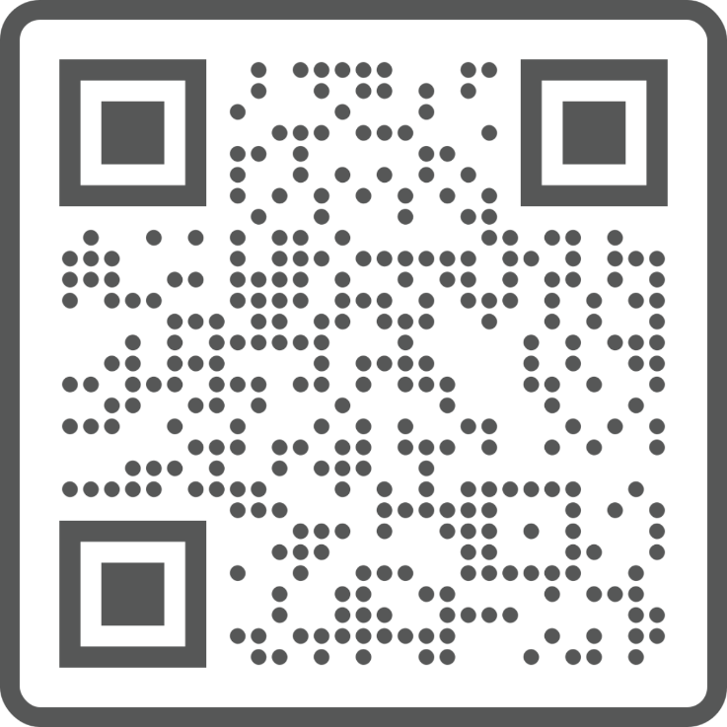
Did you know anyone in England can get a free at home hepatitis C testing kit?
Visit: https://hepctest.nhs.uk/ref/cul
or scan the QR code:

Slide 5
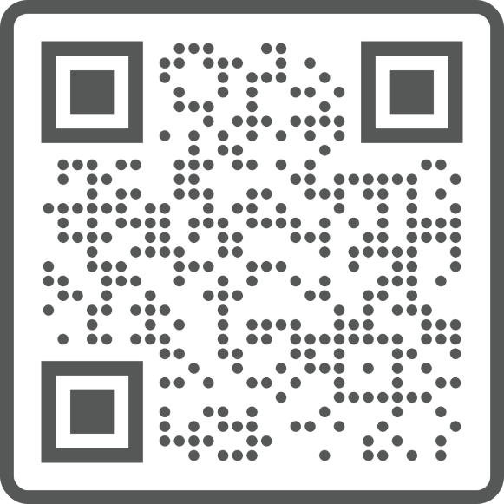
Further Resources
For more resources including case studies, guidance, leaflets and training materials visit HepCULater.com/resources
To access free basic hepatitis C awareness CPD Accredited Online Training use the QR code below:

Slide 6
Follow Us/Join Our Mailing List
Hep C U Later
HepC_U_Later
Hep C U Later
Register for our newsletter

